Slide 1

Cat Map
Devlin Hamill, Vandan Amin, Chaker Baloch, Eli Holter, Krai Pongrapeeporn, and Austin Sill

Slide 2
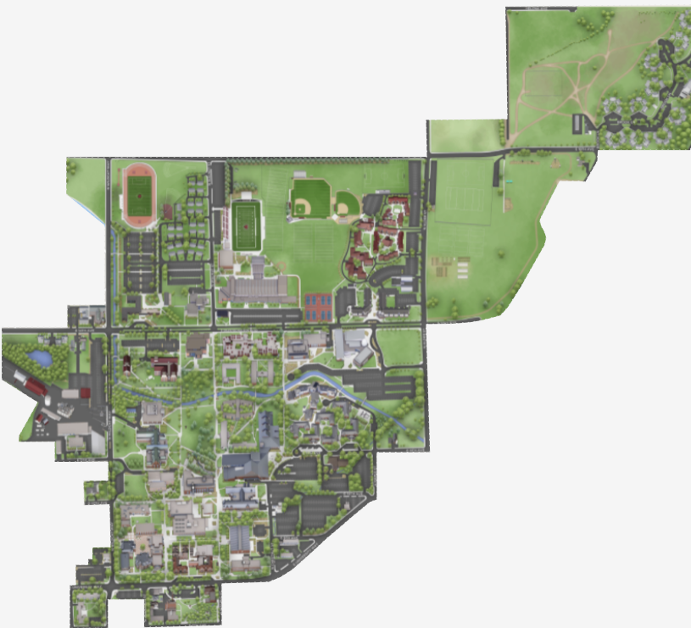
Introduction
Our goal: To make campus navigation simple and stress-free!
What We Offer: An easy way to stay informed on when and where events and classes are taking place on campus.
How We Do It: A digital map and schedular to manage the when and where of campus events.

Slide 3
Who We're Helping
Userbase:
New students unfamiliar with campus layout.
Busy students juggling multiple classes and events.
Transfer students adjusting to a new environment.
Faculty/staff navigating to meetings or events.
The Problem:
Difficulty finding buildings, or event locations.
Wasting time getting lost or being late.
Lack of a centralized tool for schedules and campus maps.
Our Solution:
"Cat Map provides a one-stop solution for navigation and scheduling, making campus life easier for everyone."

Slide 4
How We Solve These Problems
Interactive Campus Map:
Real-time directions to classrooms, buildings, and events.
Searchable locations for easy navigation.
User-Friendly Design:
Simple, intuitive interface for any student.
Key information available at a glance.
Centralized Tool
Combines navigation and scheduling into one app.
Reduces stress and saves time for busy students.

Slide 5
Core Features
Components of the App

Slide 6
Home Page Objectives
Simplicity – Simple UI to convey information:
The homepage features a clean, minimalistic design to avoid overwhelming users.
Key information (e.g., next class, directions) is displayed prominently.
Intuitive buttons guide user through the UI.
Legibility – Easy to understand on first glance:
Large clearly legible fonts and high-contrast colors ensure readability.
Most relevant information is prioritized in the visual design
Accessibility – Daily information is available immediately:
Infromation is available as soon as the app is opened.
Show a simple breakdown of the user's day.
Logical Flow – The design should convey its usage to the user:
Clear call to action with automatic pathing to next event

Slide 7
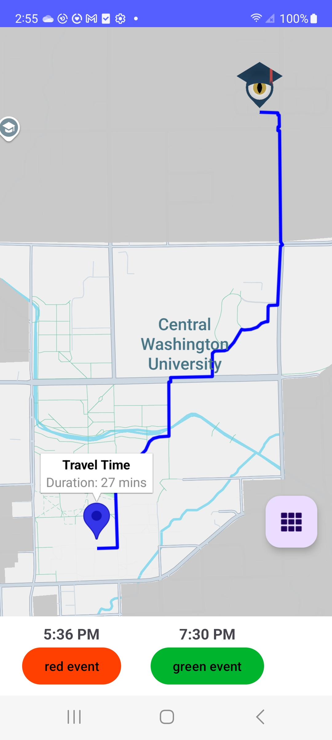
Home Page Features
Path – Guiding User to next event:
Includes real-time navigation that updates with user position
Will automatically switch to new destination after the previous event has elapsed
Shows approximate time to destination
Events – Listed in order of current relevance
Listed in chronological order
Excludes already past events
Times – Listed above each event
Shows more detailed information about start time.

Slide 8
Locations Objectives
What are the user's location needs?
See a list of all locations on campus
Learn about and view locations on campus
Navigate to any location on campus
Track/identify their favorite locations
How can we meet these needs?
List locations on campus
Provide information about each location
Allow the user to "favorite" a location

Slide 9
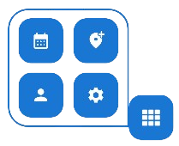
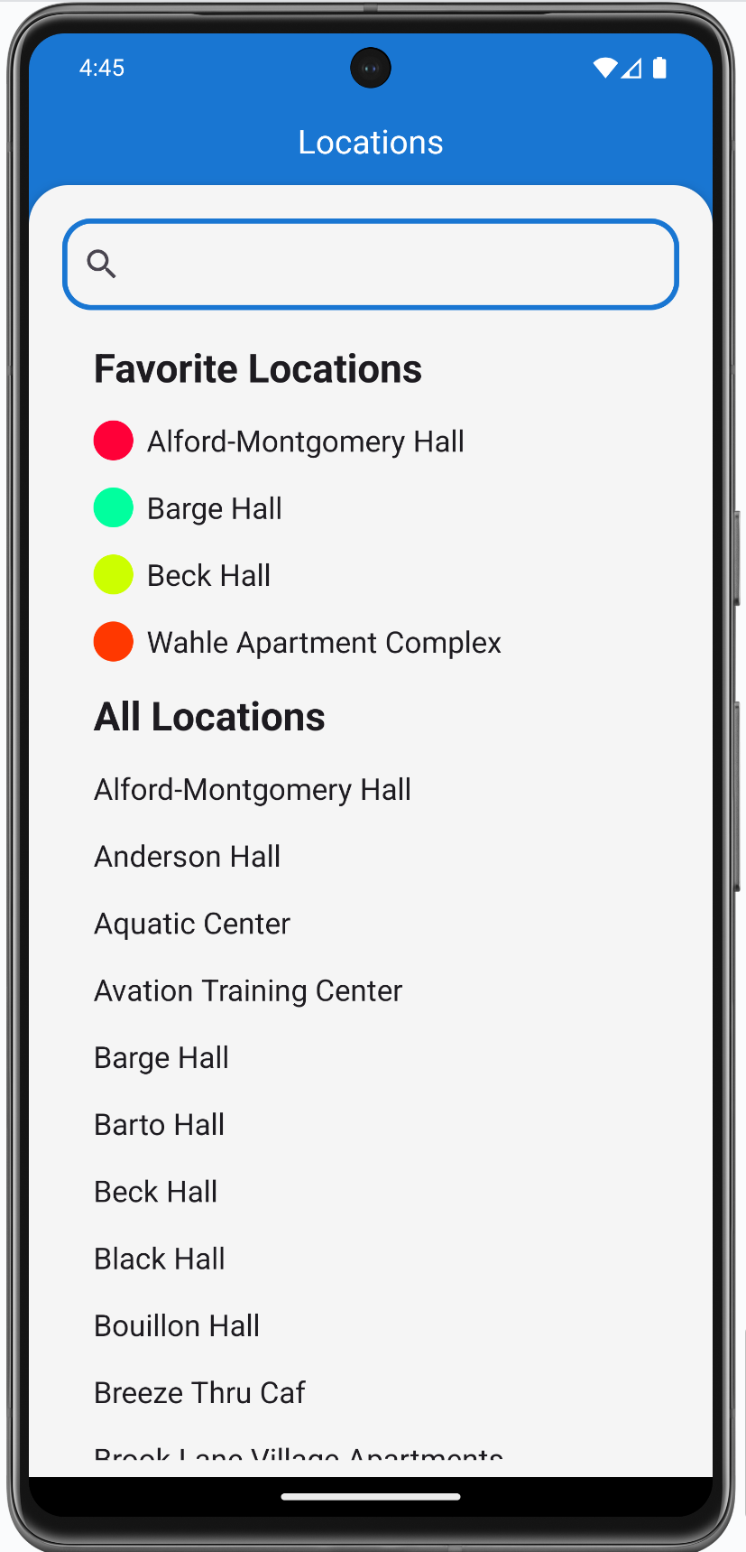
Locations
Location information is needed to navigate to locations
App stores location information locally
Locations are searchable
Locations page shows favorited and all locations

Slide 10
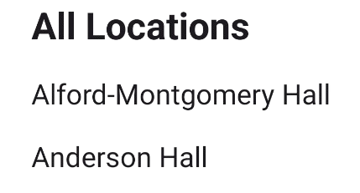
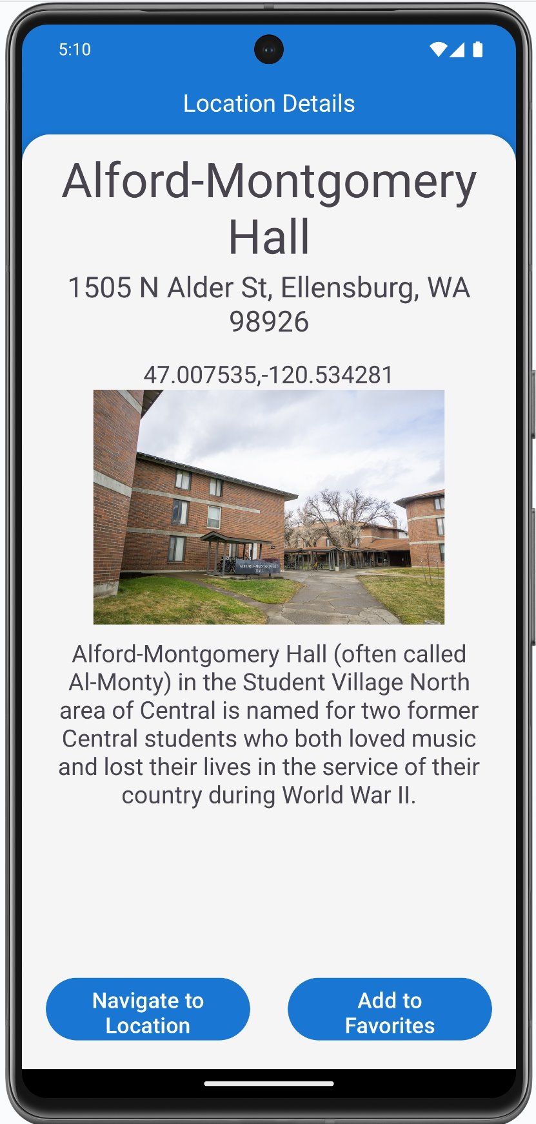
Location Details
Location information is displayed
Location name, address, coordinate, picture and description are stored
User can navigate to the selected location
User can add the selected location to their favorites

Slide 11

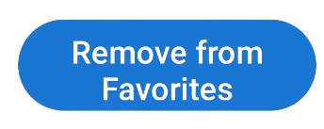
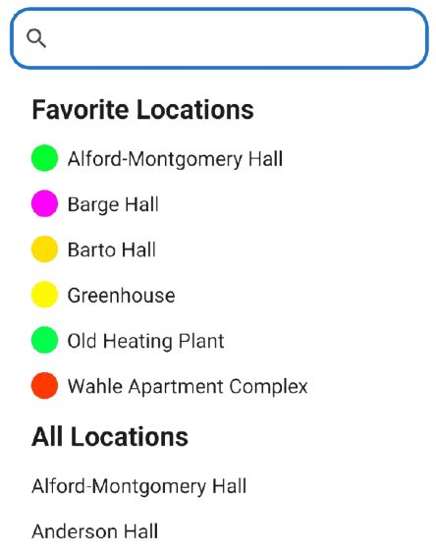
Favorite Locations
Favorite locations listed at top of locations page
Location can be added to/removed from favorites on info page
Color chosen when adding location to favorites
Favorite locations stored in Firestore
Notes:
Mention favorite locations color not being used to

Slide 12
Schedule Objectives
Users are able to add, view, and edit to their schedule for specific event or class.
Users can see a view weekly view which will show all the events within the selected week.
Monthly view which will show the events for the current selected day and suggestion stuff for the week if the current day doesn’t have any event.
They can also modify and create new classes events through a class management tab.

Slide 13
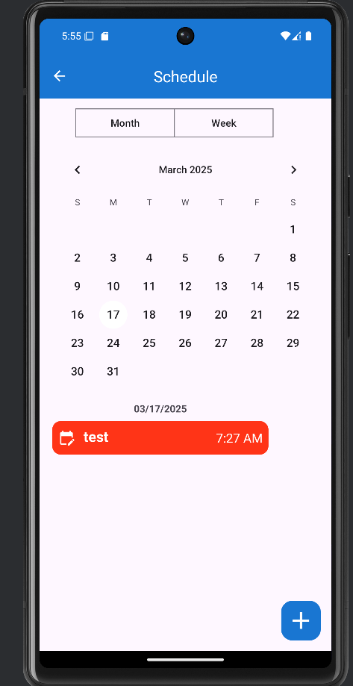
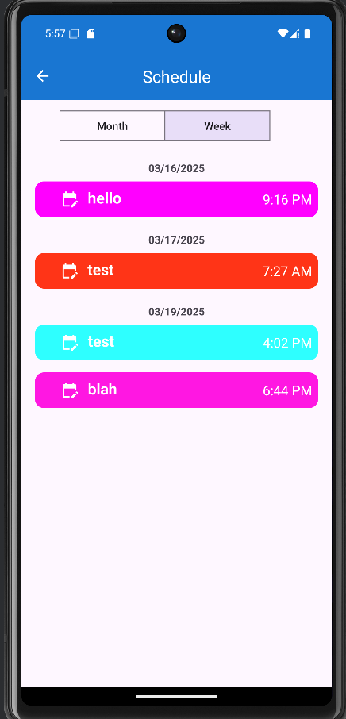
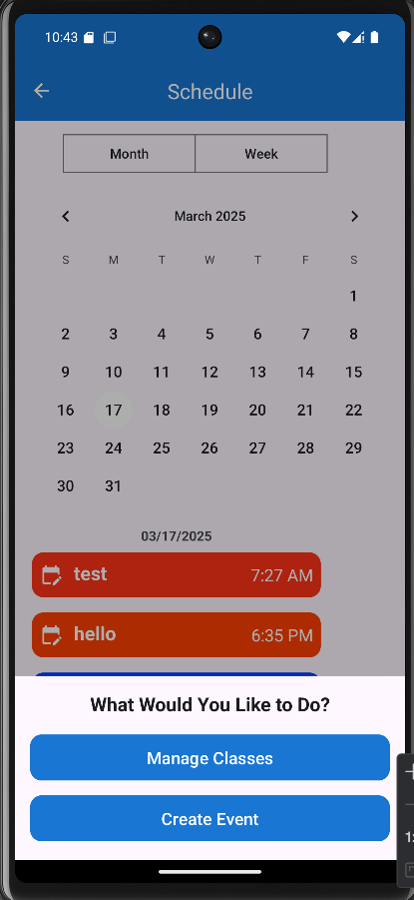
Viewing Schedule

Slide 14
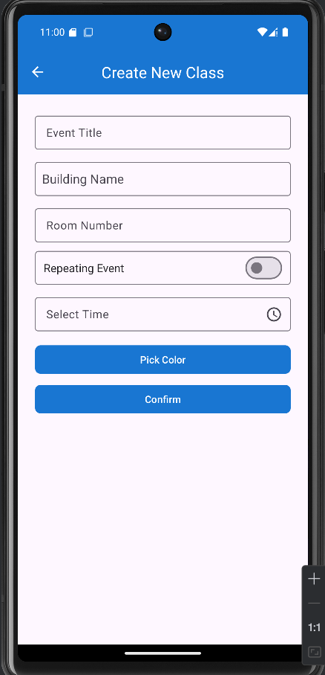
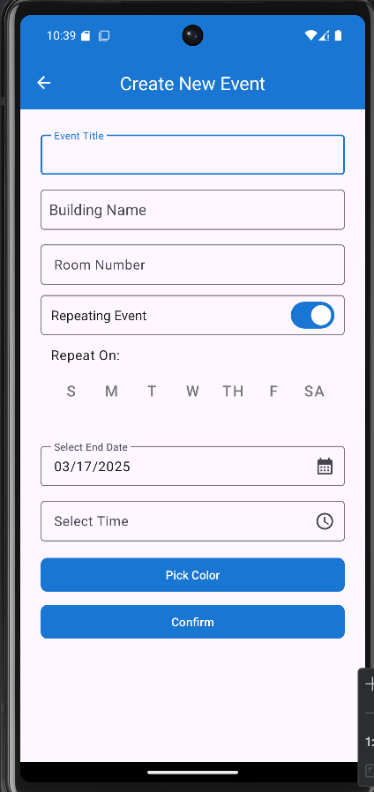
Add Event / Add class

Slide 15
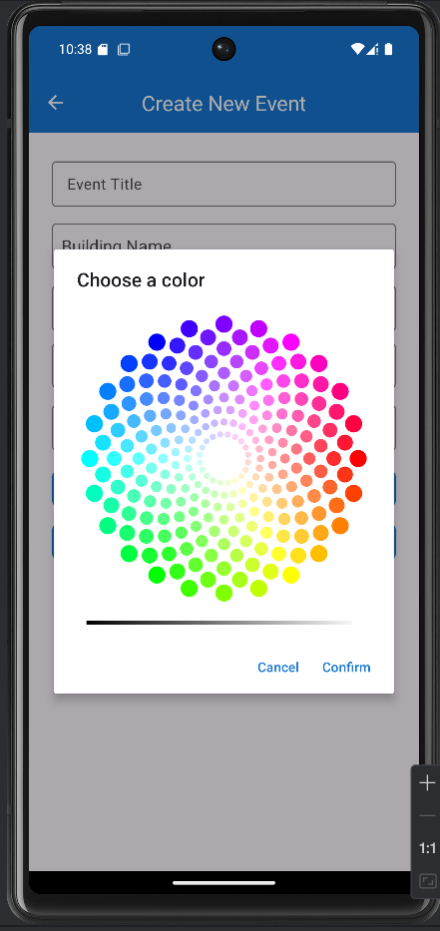
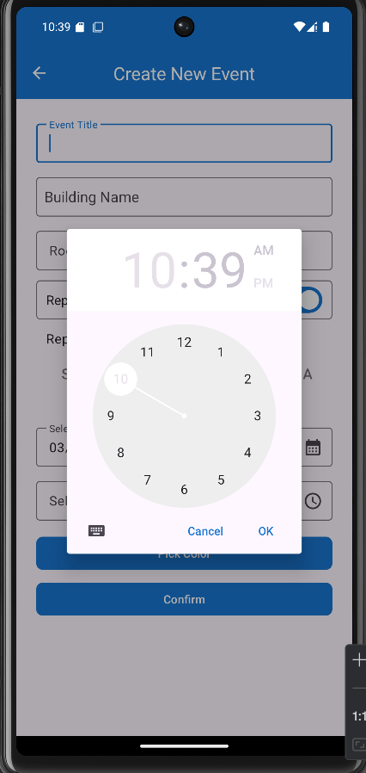
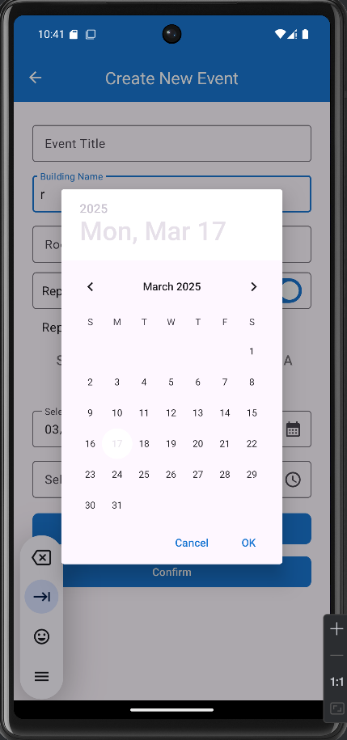
Edit / Add Functionality

Slide 16
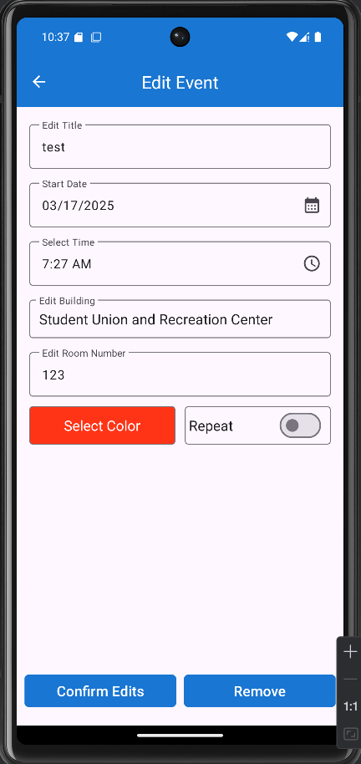
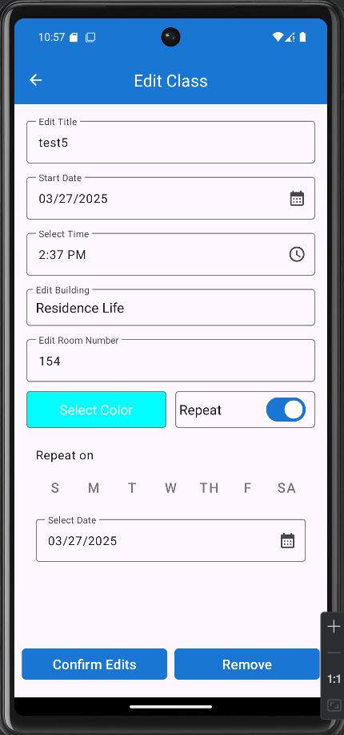
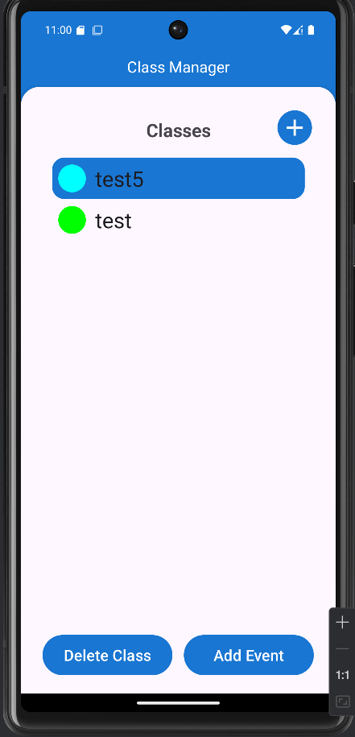
Editing Event / Edit Class

Slide 17
Class Objectives
What are the user's class needs?
Classes need to be different from events because they can:
Have multiple meeting places
Happen at different times
Happen at different times
Class events need to be modifiable as a group
How can we meet these needs?
Provide a class manager to enable these features

Slide 18
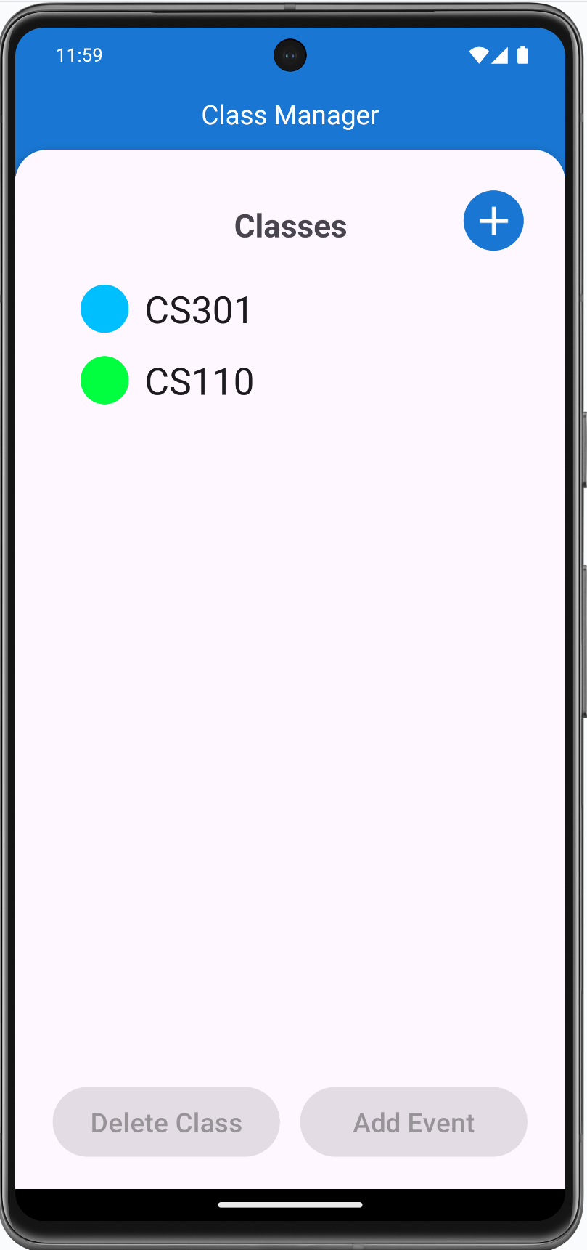
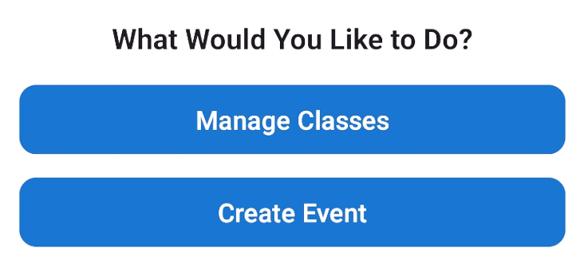
Class Manager
Classes are separate from events
All class events take their name and color from their class
New classes can be created
One class can have multiple events
All class events can be deleted at once

Slide 19


Account System Objectives
Main Objectives
Easy and accessible sign in & sign out
Google Accounts
Login with Google Accounts
Google Auth password reset
User must create an account to sync their data
Account retrieval

Slide 20
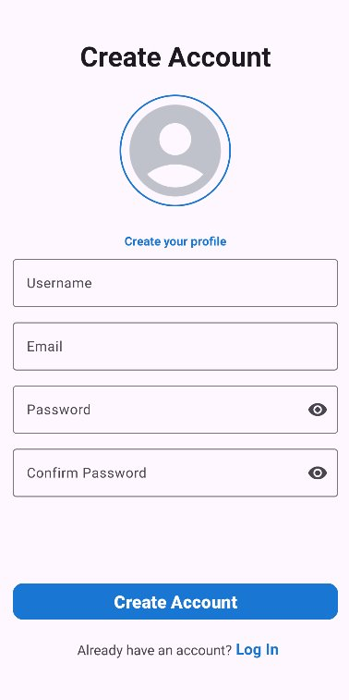
Account System Features
Email & Password Sign Up
Personalization using usernames and profile pictures
Mandated strong passwords

Slide 21
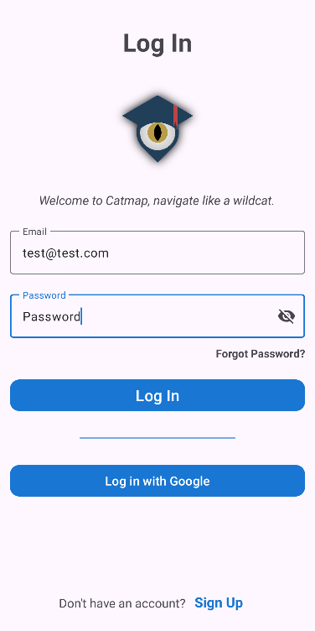
Account System Features
Email & Password Sign In
Firebase Auth integration
Secure and encrypted by Google
Supports any e-mail domain

Slide 22
Account System Features
Google Accounts
Third-party sign in with a Google Account
Sign up and sign in with single click
Session Management
User stays logged in between app launches with Firebase Auth session management

Slide 23
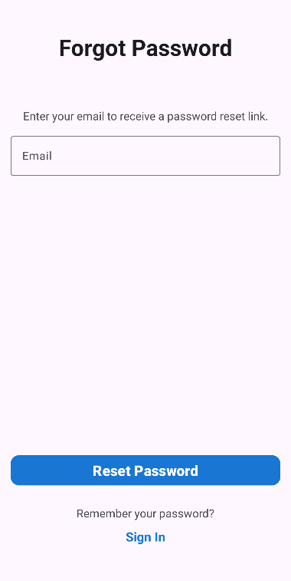
Account System Features
Account Retrieval
Reset your password via email link

Slide 24




Dynamic & Secure Profile Management
Profile
Image Upload
Password/Username Management
Firebase
Real-Time
Updates

Slide 25
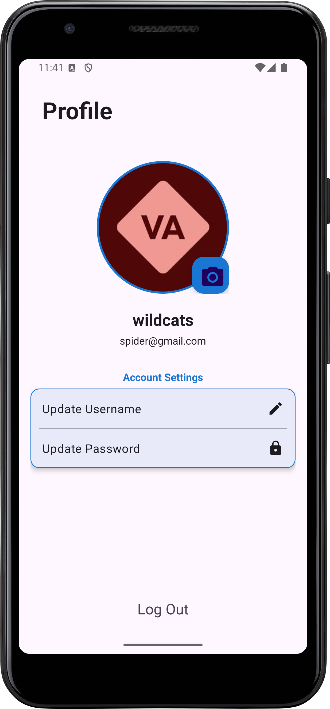
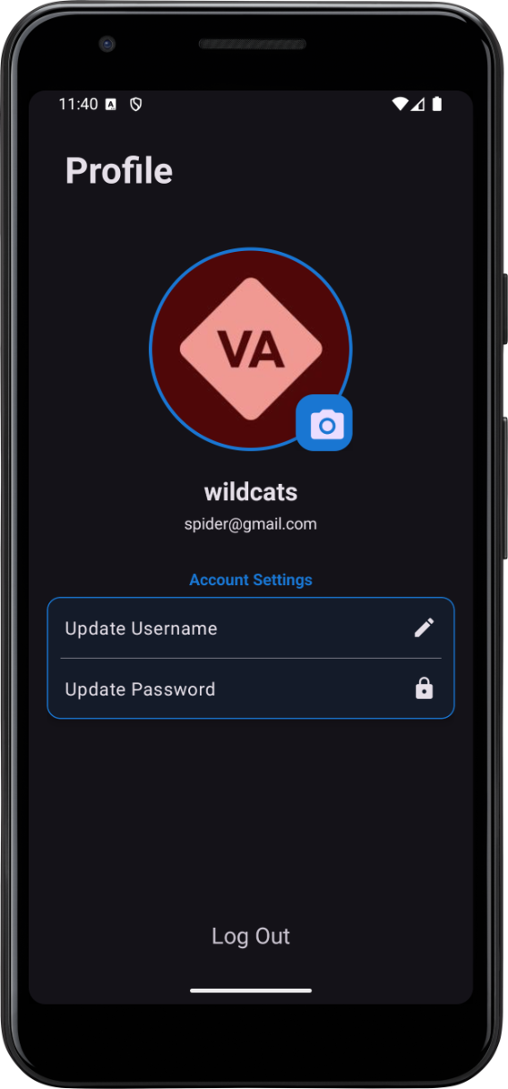


Dark Mode

Slide 26
External Dependencies
Google Maps API
Google Routes API
Google Firebase
Firestore
NoSQL database
Scalable with database sharding
Authentication
Secure with HTTPS & AES-256 encryption
Google OAuth2
Alternative login solution

Slide 27
Data Storage and Transmission
Local Storage
Hardcoded Data
Location information (not favorite locations)
JSON to store location info
Images stored in JPG files
Local Memory
App theme stored in Shared Preferences
Cloud Storage
users_collection
Stores information about user not tracked by Firebase Authentication
Events
Each event is stored in a document
Events and class events are stored in the same collection
favorite_locations_collection
Each favorite location is stored in a document

Slide 28

Analysis
Defining the app requirements and user needs
Planning
Structuring the app architecture and features
The Iterative Approach
Testing
Debugging, optimizing, and ensuring usability
Development
Implementing the app functionality and UI

Slide 29
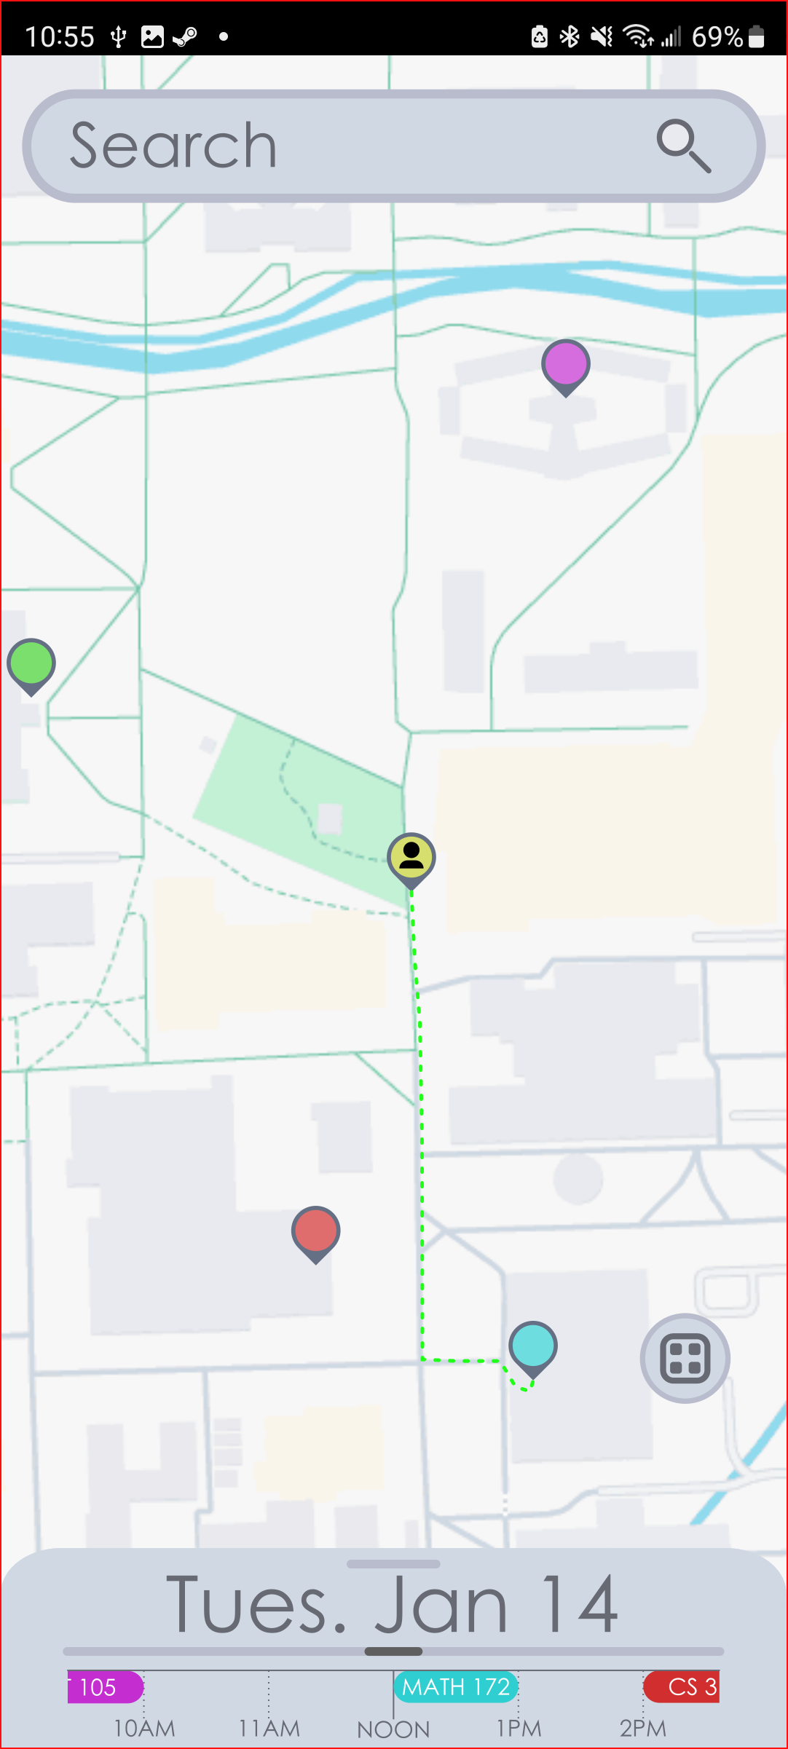
Project Timeline
Inception to presentation, motives, feature creep, and feature loss.

Slide 30
Project Inception
Initial Vision:
To combine the functionality of both a map and schedule into one application.
The goal was to make this a seamless integration that helped students navigate.
Main Goals:
Provide real-time directions to classes and events.
Integrate scheduling and maps into an easy-to-use system.
Early Ideas and Motivations:
Making the app accessible to as many students as possible
Making the app adaptable to user needs and preferences.

Slide 31
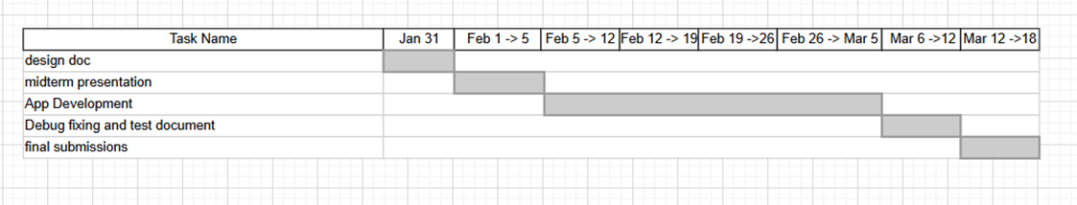
How The Project Changed
Simplified Scheduling:
Originally, we had in mind a schedule that would show the length of events. As we worked we shifted our focus to just the start time of events.
Simplified Displays:
Out original designs were not taking into account the small display size of the standard phone as they were mostly developed on a larger screen.
Where We Landed:
The final product is trimmed down to better suit the needs of the user. This makes for a better overall user-experience.

Slide 32
Features We Lost
Colorblind Mode:
Initially planned to assist colorblind users.
Our design become more monochromatic, so this feature became redundant.
Wheelchair Routing:
Intended to guide users to wheelchair accessible building entrances.
Cut due to time constrain's, also most locations were already ADA compliant.
Integration of National Holidays:
Designed to automatically cancel "class" events if they were on a designated national holiday.
May still be added to features in the future
Left-handed mode:
Feature designed to change the user interface to suit left-handed users
May still be added to features later

Slide 33
Features we Lost (Continued)
Event Groups:
Got converted into event type's that only consist of "Classes" and "Events"
Google Calender API:
We don’t pull events or integrate events to and from Google calender API.
Local to online:
We switched to an online based storage for profile info and schedual info instead of storing it locally.
Notifications:
The app was supposed to give an android notification when an event was about to arrive 10 minutes before it happens this was scrapped.
Time restrictions:
We were originally going to restrict users from adding conflicting times on events. Due to the pacing we had to scrap this and left it in the hands of the user.

Slide 34




Future Features
Indoor Navigation
CWU
Event Integration
Multi-Modal Routing
Virtual
Campus Tour

Slide 35
Live Demo

Slide 36
Questions?

